Slide 1
New MSc curriculum (one year experience)
Stanimir Stoyanov
University of Plovdiv

Slide 2
Rationale
More than 10 years experience carrying the old program
More than 800 students
Weaknesses of the program
Full-time education (weekends)
Limited time
Different background
Insufficient attention to home work
Insufficient attention to practical skills
Consultation with students
Notes:
Program was changed continuously but we decided to undertake more deeper changes.
Two years ago we were going to analyze this period and accordingly some shortcomings of the program had been addressed.
Full-time education conducted in weekends

Slide 3
MSc Overview
Subject: Software Engineering
Duration:
1 year
3 terms
Learning method:
Project-oriented education
Full-time education supported by software tools (blended learning)
Number of students: 80
Staff: 5
Completion:
Thesis
State examination

Slide 4
Curriculum
Basics
Specialization & Project
Java Practicum (5)
SOA (5)
Intelligent Agents (5)
Internet Programming Environments (5)
Semantic Services (5)
Semantic Web (5)
DB Integration (5)
Project (10)
Pattern-Oriented Programming (5)
Theses
Advances in SE (5)
eLearning (5)
Theses (15)
Notes:
Mandatory and elective courses

Slide 5
Conclusions
Students are satisfied & happy
Staff is satisfied but not happy
Without supporting tools (DeLC) not possible to conduct the program
No return …
Notes:
I can draw the following conclusions.
The program was adopted by the Academic council of the University of Plovdiv.

Slide 6
Why the students are satisfied & happy?
Training close to the real conditions for the development of software
Practical experience in software development close to the reality
Team work is preffered
Effective use of limited time
90% of students graduate with a thesis

Slide 7
Why the staff is satisfied but not happy?
Satisfaction due to:
Successful completion of the program
Students are satisfied and happy
Co-operation and activity of students increase
Unhappiness due to:
Significant workload due to the increase in the number of hours (individual work with students)
Any-where, any-time, any-how in good condition
Staff selection
Notes:
ultimately succeed to complete the program

Slide 8
Why DeLC needed?
Successful implementation of the program was possible by the use of supporting tools
DeLC
Prototype environment for context-aware provision of educational services
Tools:
Education portal: educational services
Education cluster: services’ support by software assistants
Supported activities:
Provision of teaching material
Testing and assessment
Planning and scheduling
Project and thesis development

Slide 9
Education Portal
User Interface
E-Services
Ext Interfaces
Module ‘eLectures’
Module
‘eTesting’
Module
‘Scheduie’
User Profiling
Educational e-Services
IntegrationEngine
SCORM Engine
Test Engine
Event Engine
Digital Libraries
Catalogue
. . .
DLib
DLib
DLib

Slide 10
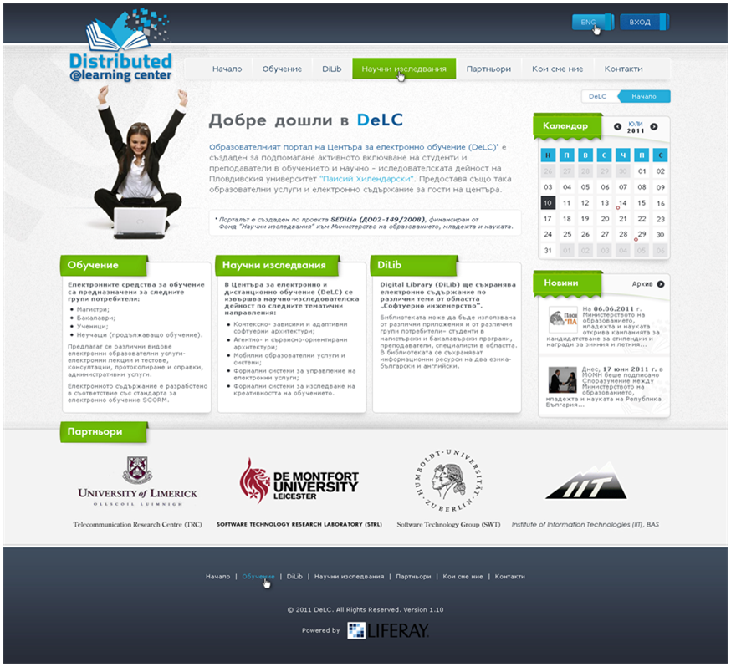
Education Cluster
Agent Village
eTesting Assistants
Refactoring eLearning Environment (ReLE)
Refactoring Agent (RA)
Evaluator
Local control
Working Desk
sensors
Fraud Detector
RAnal
Behav
Statistician
Knowledge base
effectors
JADE
Eclipse (IDE)

Slide 11
Teacher’s vs. Agent’s Assessment

Slide 12
No return …
MSc program adopted by the Academic Council
Staff remains the same composition
Some ways to improve the situation:
Improvement staff qualification
Enhancement supporting tools
Improvement reusability of the teaching content
Better planning and optimal organization of the program implementation

Slide 13
What about supporting tools in the next year?
Completing of:
SCORM engine
New version of eTest engine (QTI compatible)
Improving of portal architecture
Messaging bus
Enhancement of Agent Village environment
Improving of agents’ behavior
Ontologies
Formalizing of DeLC architecture
CCA

Slide 14
Thank you!

